Slide 1

Network Graphs and the Semantic Web with Python
Michigan Python
Notes:
<number>

Slide 2
The Basis for a Digital Thread
Digital threads seek to create homogeneity and simple universal access to data.
Single set of related data as it weaves in and out of business processes and functions to create continuity and accessibility.
Data needs to be distributed across computers that create and store the data
Although we can place restrictions in place, data distribution relies on the slogan: Anyone can say Anything about Any topic (AAA)
Server 1
Server 2
Server 3

Slide 3

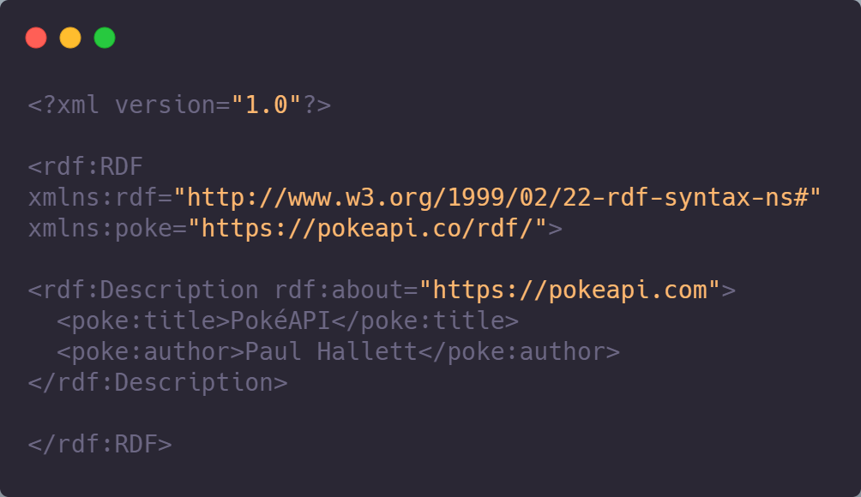
Resource Description Framework (RDF)
Family of World Wide Web Consortium (W3C) specifications
Originally designed as a metadata data model and first published in 2004
General method for conceptual description or modeling of information that is implemented in web resources

Slide 4
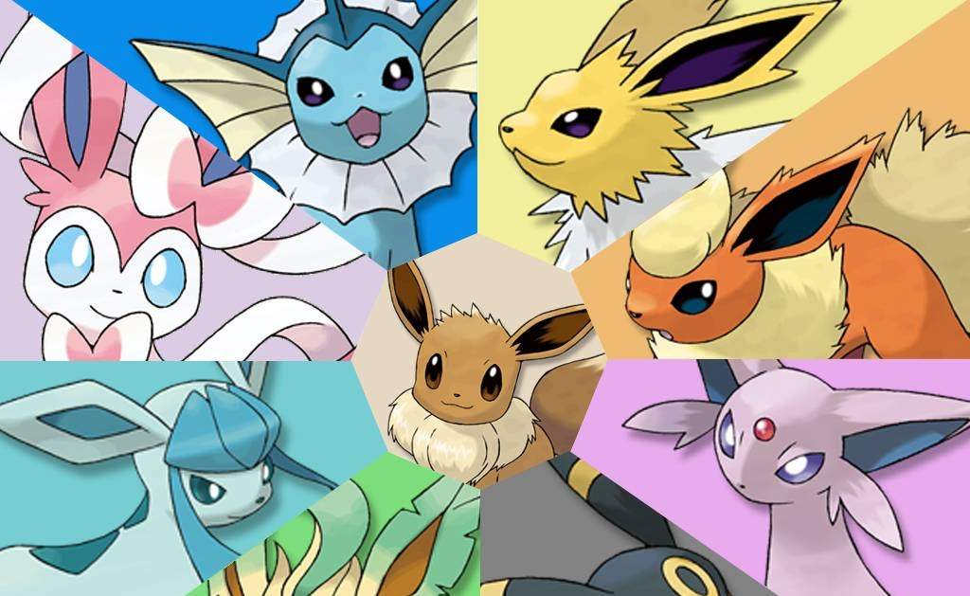

Slide 5
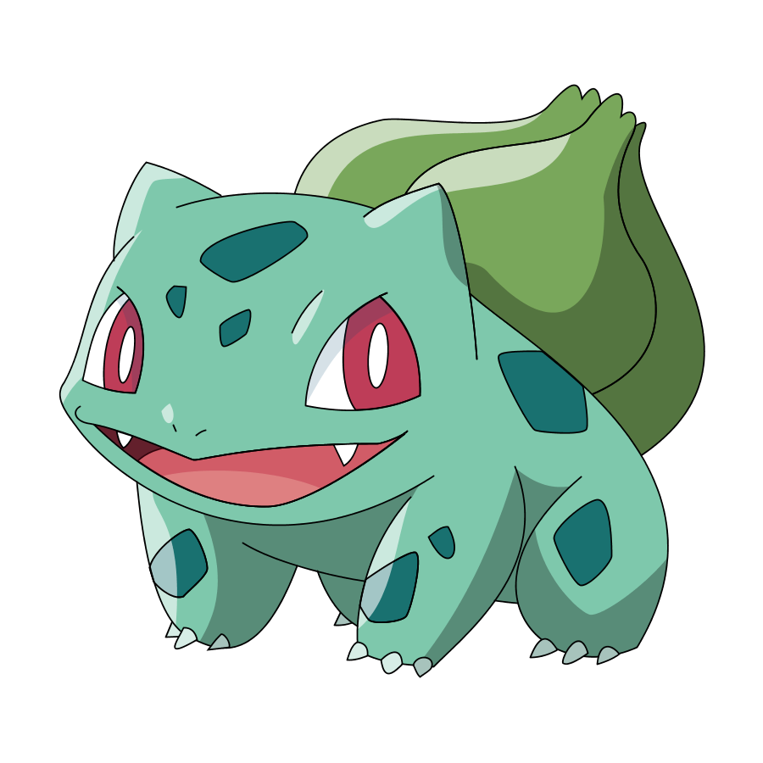
Representing Pokémon as Data
ID | Species ID | Height | Weight | Base Experience
1 | Bulbasaur | 7 | 69 | 64
2 | Ivysaur | 10 | 130 | 142
3 | Venusaur | 20 | 1000 | 236
4 | Charmander | 6 | 85 | 62
5 | Charmeleon | 11 | 190 | 142
6 | Charizard | 17 | 905 | 240
Each Row is an Item We are Describing (a Pokémon), and Each Column is a Property of Those Items (Pokémon metadata)

Slide 6
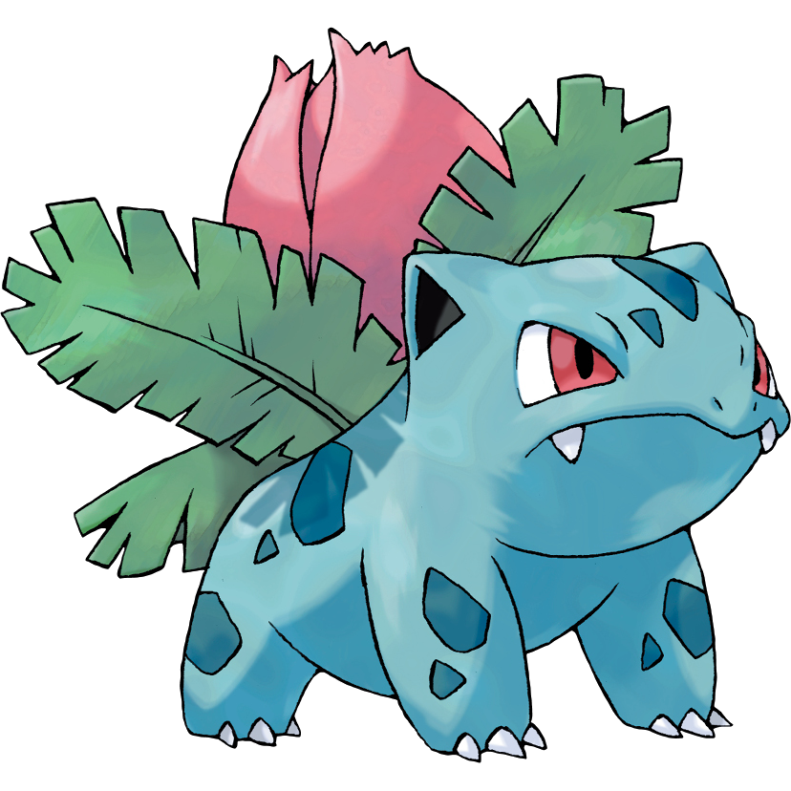
Distributing Data Row by Row
1 | Bulbasaur | 7 | 69 | 64
2 | Ivysaur | 10 | 130 | 142
Server 1
3 | Venusaur | 20 | 1000 | 236
4 | Charmander | 6 | 85 | 62
Server 2
5 | Charmeleon | 11 | 190 | 142
6 | Charizard | 17 | 905 | 240
Server 3
Distributing Data by Rows Requires a Common Schema to Coordinate Across the Servers - Which Column is Which?

Slide 7

Height | Weight
7 | 69
10 | 130
20 | 1000
6 | 85
11 | 190
17 | 905
Distributing Data Column by Column
Server 2
ID | Species ID
1 | Bulbasaur
2 | Ivysaur
3 | Venusaur
4 | Charmander
5 | Charmeleon
6 | Charizard
Base Experience
64
142
236
62
142
240
Server 1
Server 3
Distributing Data by Columns Requires Reference Entities to Coordinate Across the Servers - Which Thing Are We Talking About?

Slide 8

ID | Height
1 | 7
Distributing Cell by Cell
Server 2
ID | Species ID
4 | Charmander
Server 1
ID | Base Experience
6 | 240
Server 3
Distributing Data by Cells Requires References to Both Schema and Entities
Carries the Cost of Both, but Truly Allows AAA

Slide 9
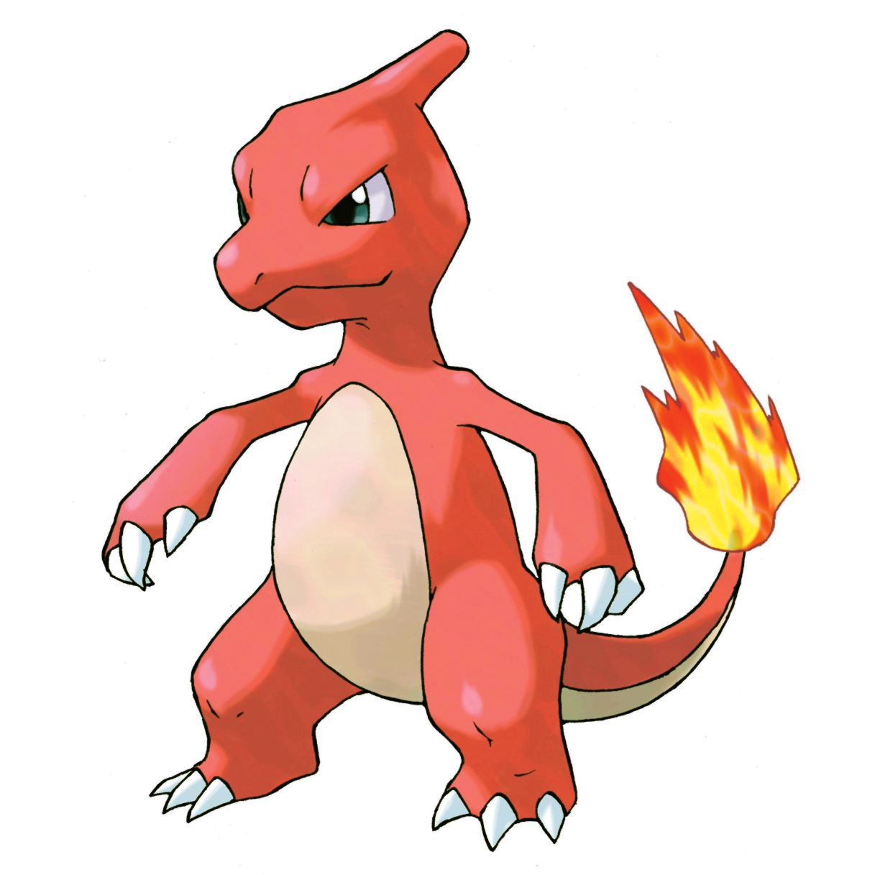
Each Cell Has 3 Values
Global Reference for the Column
ID | Base Experience
6 | 240
Global Reference for the Row
The Value in the Cell
A Single Cell is Represented by 3 Values This Basic RDF Building Block is Called the Triple

Slide 10
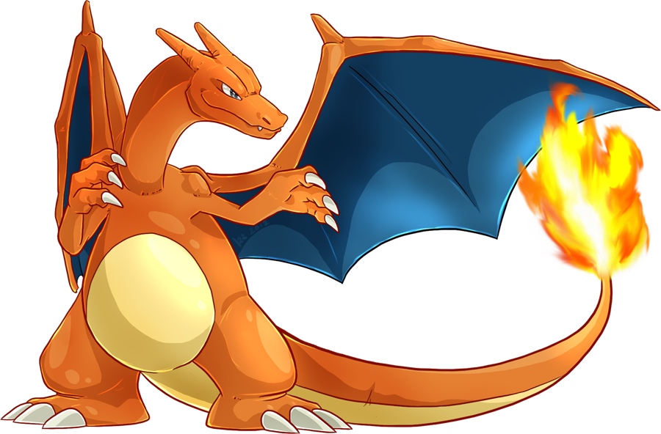
RDF Uses Grammar Names
Predicate
ID | Base Experience
6 | 240
Subject
Object
Subject is the Thing the Statement is About Predicate is the Property of the Entity Object is the Value

Slide 11



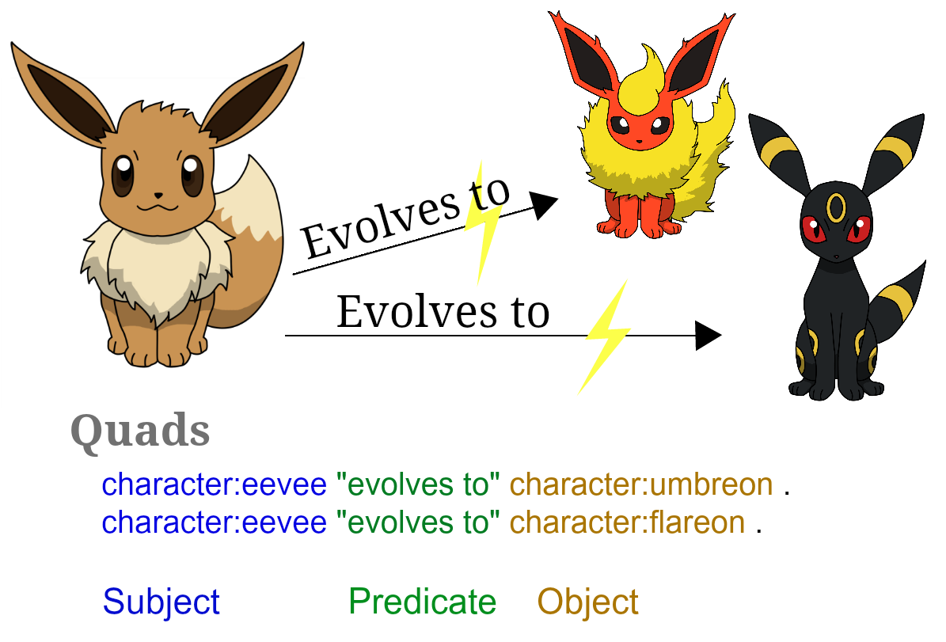
Sample Triples

Slide 12

Graph Display of Triples
1
Evolves to
Name
Height
2
Evolves to
Balbasaur
3
Weight
7
Base Experience
69
Name
Name
64
Height
Height
Ivysaur
Venusaur
Weight
Weight
10
Base Experience
20
100
130
142
236
Base Experience
In a Graph Form, the Subject and Objects are Nodes (Vertices) and the Predicates are the Lines (Edges)

Slide 13

Merging Data
We want to distribute data over multiple computers or sources
If we want to use the data, we must merge the data back together
Since information is represented as triples, merging data is done by forming the graph of all the triples
Need to answer: When is a node in one graph the same node as a node in another graph?
Subject | Predicate | Object
Charmander | sourcedFrom | https://pokeapi.co/api/v2/
Charmeleon | sourcedFrom | https://pokemondb.net/pokedex
Charizard | sourcedFrom | https://www.pokemon.com/us/pokedex/

Slide 14
Unique IDs
Uniform Resource Identifiers (URI) is how the web shows things are unique
For example: Uniform Resource Locator (URL) is a type of URI, like https://michiganpython.org
We can use these URIs as a global identifier
Subject | Predicate | Object
PokeAPI: 1 | Evolves to | PokeAPI: 2
Pokedex: 1 | Pokedex: Name | Bulbasaur
Pokedex: 1 | RDF: type | Pokedex: Pokemon
Pokedex: 1 | W3-OWL: sameAs | Dbpedia: Bulbasaur
Unique IDs with URIs Create a Namespace to Know When Nodes in a Graph Match

Slide 15
Defining Types of Names
Subject | Predicate | Object
Pokedex: gender | RDF: type | RDF: Property
There is a RDF Namespace to Particular Entity That is Used as an Agreed Base Dictionary

Slide 16

rdflib
Work with RDF in Python including:
Parsers & Serializers
Store implementations
Graph interface
SPARQL

Slide 17

Python package for the creation, manipulation, and study of the structure, dynamics, and functions of complex networks

Slide 18
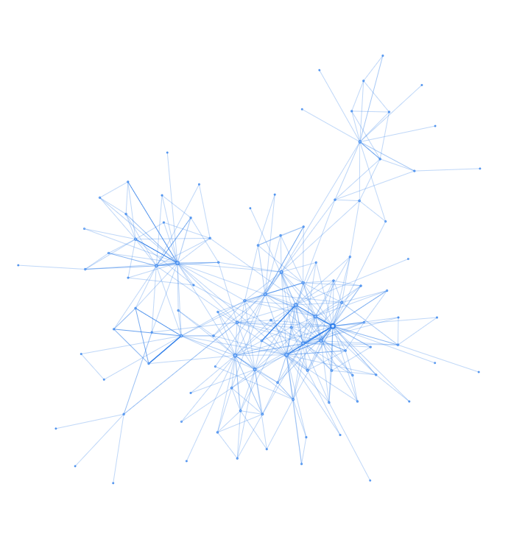
pyvis
Create and visualize interactive network graphs with Python
(not to be confused with pyviz)

Slide 19
Demo

Slide 20

dan@yeaw.me
@danyeaw
Presentation
Dan Yeaw
Thank You!
Name
Creator
Email
Twitter
Notes:
<number>

